Slide 1
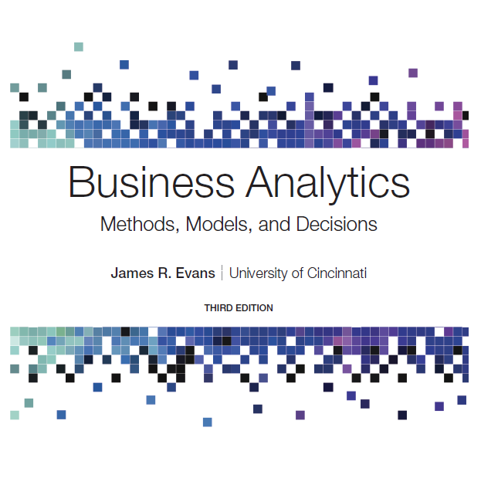
Business Analytics: Methods, Models, and Decisions
Third Edition
Chapter 10
Introduction to Data Mining
Copyright © 2020, 2016, 2013 Pearson Education, Inc. All Rights Reserved
Notes:
If this PowerPoint presentation contains mathematical equations, you may need to check that your computer has the following installed:
1) MathType Plugin
2) Math Player (free versions available)
3) NVDA Reader (free versions available)

Slide 2
Data Mining
Data mining is focused on better understanding of characteristics and patterns among variables in large databases using a variety of statistical and analytical tools.
It is used to identify relationships among variables in large data sets and understand hidden patterns that they may contain.

Slide 3
The Scope of Data Mining
Cluster Analysis
identifying groups in which elements are in some way similar
Classification
analyzing data to predict how to classify a new data element
Association
analyzing databases to identify natural associations among variables and create rules for target marketing or buying recommendations
Cause-and-effect Modeling
developing analytic models to describe relationships between metrics that drive business performance

Slide 4
Cluster Analysis
Cluster analysis, also called data segmentation, is a collection of techniques that seek to group or segment a collection of objects (observations or records) into subsets or clusters, such that those within each cluster are more closely related to one another than objects assigned to different clusters.
The objects within clusters should exhibit a high amount of similarity, whereas those in different clusters will be dissimilar.

Slide 5
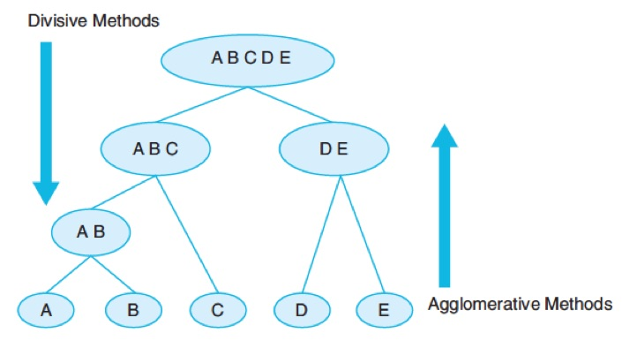
Clustering Methods
Hierarchical clustering
Agglomerative clustering methods, which proceed by series of fusions of the n objects into groups.
Divisive clustering methods, which separate n objects successively into finer groupings.

Slide 6
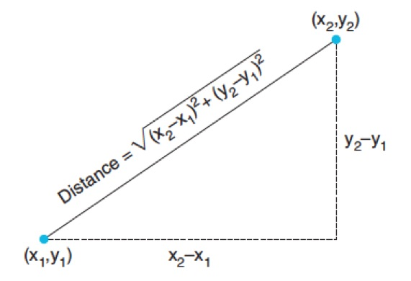
Distance Measures
Euclidean distance is the straight-line distance between two points.
The Euclidean distance measure between two points

Slide 7
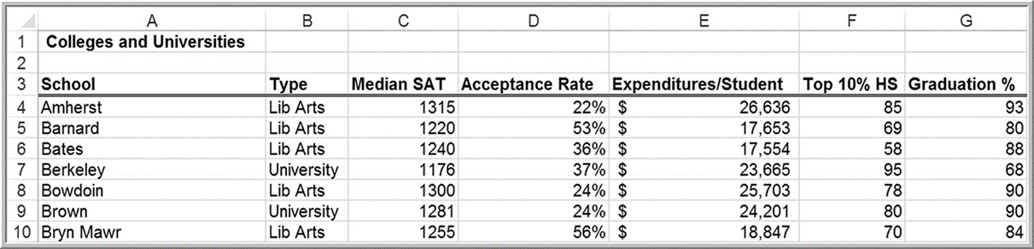
Example 10.1: Applying the Euclidean Distance Measure
Colleges and Universities
The distance between Amherst and Barnard is

Slide 8
Normalizing Distance Measures
Convert to z-scores
Normalized distance measure between Amherst and Barnard is
blank | Amherst | Barnard | Bates | Berkeley | Bowdoin
Amherst | 0 | 3.5284 | 2.7007 | 4.2454 | 0.7158
Barnard | blank | 0 | 1.8790 | 2.8901 | 2.9744
Bates | blank | blank | 0 | 3.9837 | 2.0615
Berkeley | blank | blank | blank | 0 | 3.8954
Bowdoin | blank | blank | blank | blank | 0

Slide 9
Single Linkage Clustering
An agglomerative method that keeps forming clusters from the individual objects until only one cluster is left.
In the single linkage method, the distance between two
clusters r and s,
is defined as the minimum
distance between any object in cluster r and any object in cluster s.

Slide 10
Example 10.2: Single Linkage Clustering (1 of 4)
blank | Amherst | Barnard | Bates | Berkeley | Bowdoin
Amherst | 0 | 3.5284 | 2.7007 | 4.2454 | 0.7158
Barnard | blank | 0 | 1.8790 | 2.8901 | 2.9744
Bates | blank | blank | 0 | 3.9837 | 2.0615
Berkeley | blank | blank | blank | 0 | 3.8954
Bowdoin | blank | blank | blank | blank | 0
The smallest distance occurs between Amherst and Bowdoin (0.7158). Join these two into a cluster.
Recalculate the distance between this cluster and the remaining colleges by finding the minimum distance between any college in the cluster and the others.
blank | Amherst/Bowdoin | Barnard | Bates | Berkeley
Amherst/Bowdoin | 0 | 2.9744 | 2.0615 | 3.8954
Barnard | blank | 0 | 1.879 | 2.8901
Bates | blank | blank | 0 | 3.8937
Berkeley | blank | blank | blank | 0

Slide 11
Example 10.2: Single Linkage Clustering (2 of 4)
blank | Amherst/Bowdoin | Barnard | Bates | Berkeley
Amherst/Bowdoin | 0 | 2.9744 | 2.0615 | 3.8954
Barnard | blank | 0 | 1.879 | 2.8901
Bates | blank | blank | 0 | 3.8937
Berkeley | blank | blank | blank | 0
The smallest distance is between Barnard and Bates (1.879). Join these two colleges into a second cluster. New distance matrix:
blank | Amherst/Bowdoin | Barnard/Bates | Berkeley
Amherst/Bowdoin | 0 | 2.0615 | 3.8954
Barnard/Bates | blank | 0 | 2.8901
Berkeley | blank | blank | 0

Slide 12
Example 10.2: Single Linkage Clustering (3 of 4)
blank | Amherst/Bowdoin | Barnard/Bates | Berkeley
Amherst/Bowdoin | 0 | 2.0615 | 3.8954
Barnard/Bates | blank | 0 | 2.8901
Berkeley | blank | blank | 0
Next, join the Amherst/Bowdoin and Barnard/Bates clusters together. New distance matrix:
blank | Amherst/Bowdoin/Barnard/Bates | Berkeley
Amherst/Bowdoin/Barnard/Bates | 0 | 2.8901
Berkeley | blank | 0
Only one option remains, that is, to join Berkeley to the cluster of other colleges.

Slide 13
Example 10.2: Single Linkage Clustering (4 of 4)
If we examine the original data, we can see that Amherst and Bowdoin, and Barnard and Bates have similar profiles, but that Berkeley is quite different.
School | Type | Median S A T | Acceptance Tare(%) | Expenditure/Students | Top 10% H S | Graduation %
Amherst | Lib Arts | 1315 | 22 | $26,636.00 | 85 | 93
Bowdoin | Lib Arts | 1300 | 24 | $25,703.00 | 78 | 90
Bamard | Lib Arts | 1220 | 53 | $17,653.00 | 69 | 80
Bates | Lib Arts | 1240 | 36 | $17,554.00 | 58 | 88
Berkeley | University | 1176 | 37 | $23,665.00 | 95 | 68

Slide 14
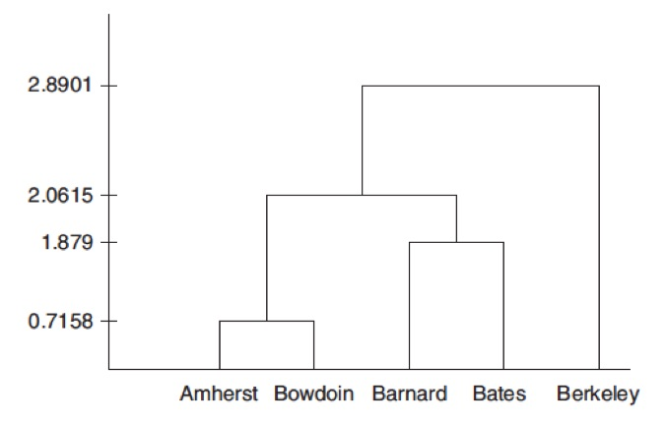
Dendogram
Visualization of the clustering process. The y-axis measures the intercluster distance. A dendogram shows the sequence in which clusters are formed as you move up the diagram.

Slide 15
Classification
Classification methods seek to classify a categorical outcome into one of two or more categories based on various data attributes.
For each record in a database, we have a categorical variable of interest and a number of additional predictor variables.
For a given set of predictor variables, we would like to assign the best value of the categorical variable.

Slide 16
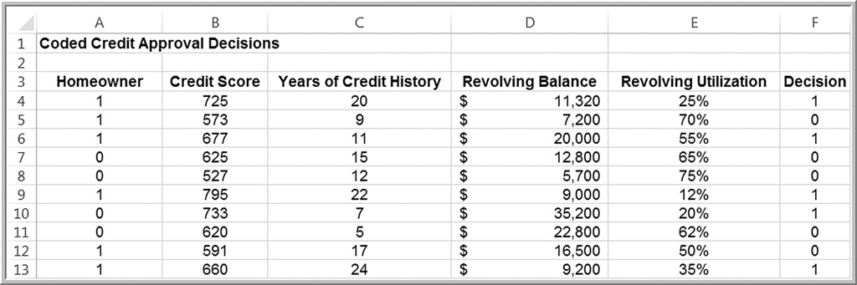
Credit Approval Decisions Data
Categorical variable of interest: Decision (whether to approve - coded as 1 - or reject -coded as 0 - a credit application)
Predictor variables: shown in columns A - E (note that homeowner is also coded numerically)

Slide 17
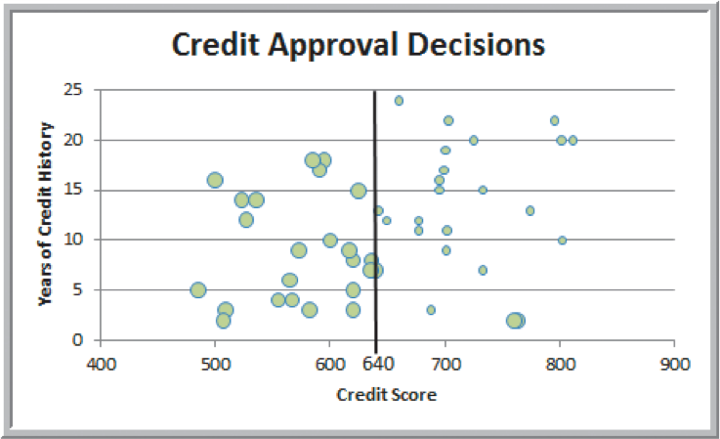
Example 10.3: Classifying Credit-Approval Decisions Intuitively (1 of 2)
Large bubbles correspond to rejected applications.
When the credit score is > 640, most applications were approved.
Classification rule:

Slide 18
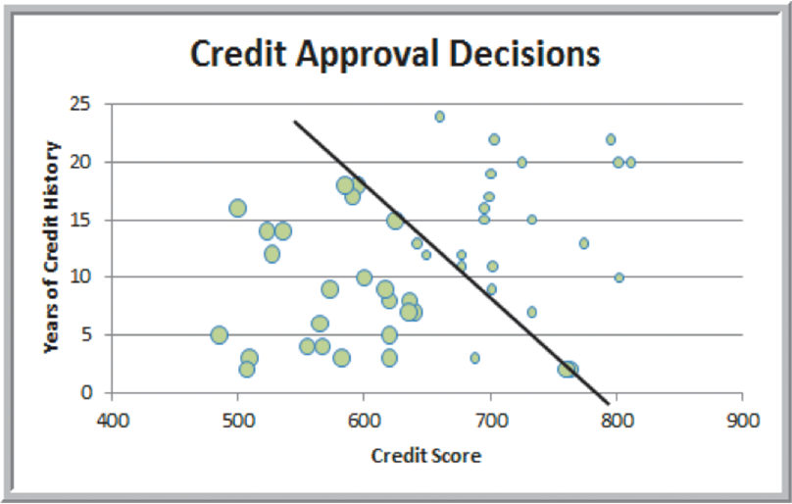
Example 10.3: Classifying Credit-Approval Decisions Intuitively (2 of 2)
Alternate classification rule using visualization

Slide 19
Measuring Classification Performance
Find the probability of making a misclassification error and summarize the results in a classification matrix, which shows the number of cases that were classified either correctly or incorrectly.

Slide 20
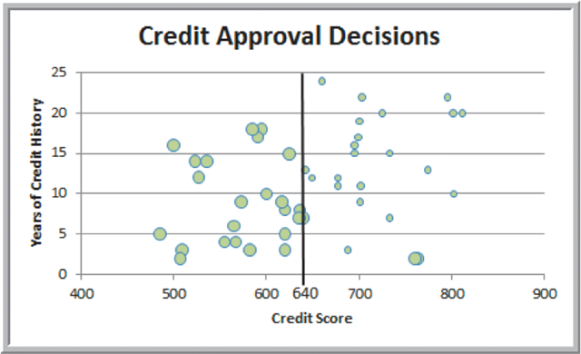
Example 10.4: Classification Matrix for Credit-Approval Classification Rules
Two applicants with credit scores exceeding 640 were rejected.
Actual Classification | Predicted classification: Decision=1 | Predicted classification: Decision=0
Decision=1 | 23 | 2
Decision=0 | 0 | 25
Off-diagonal elements are the misclassifications.
Probability of a misclassification =

Slide 21
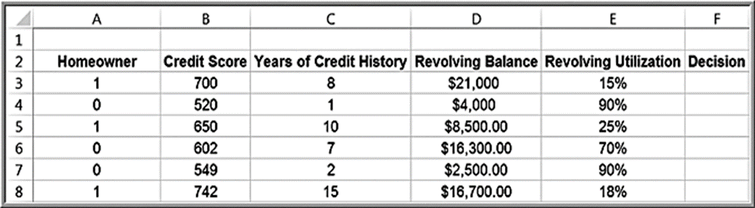
Example 10.5: Classifying Records for Credit Decisions Using Credit Scores and Years of Credit History (1 of 2)
Classify new records.
If we use the simple credit score rule (that a score of more than 640 is needed to approve an application), then we would classify the decision for the first, third, and sixth records to be 1 and the rest to be 0.

Slide 22
Example 10.5: Classifying Records for Credit Decisions Using Credit Scores and Years of Credit History (2 of 2)
Using the second rule, if
then only the last record would be approved for credit.
Homeowner | Credit Score | Years of Credit History | Revolving Balance | Revolving Utilization | Years+0.095*Credit Score | Decision
1 | 700 | 8 | $21,000.00 | 15% | 74.50 | 0
0 | 520 | 1 | $4,000.00 | 90% | 50.40 | 0
1 | 650 | 10 | $8,500.00 | 25% | 71.75 | 0
0 | 602 | 7 | $16,300.00 | 70% | 64.19 | 0
0 | 549 | 2 | $2,500.00 | 90% | 54.16 | 0
1 | 745 | 15 | $16,700.00 | 18% | 85.49 | 1

Slide 23
Classification Techniques
k-Nearest Neighbors (k-N N) Algorithm
Finds records in a database that have similar numerical values of a set of predictor variables.
Discriminant Analysis
Uses predefined classes based on a set of linear discriminant functions of the predictor variables.

Slide 24
k-Nearest Neighbors (k-N N)
The k-nearest neighbors (k-N N) algorithm is a classification scheme that attempts to find records in a database that are similar to one we wish to classify. Similarity is based on the “closeness” of a record to numerical predictors in the other records, using normalized Euclidean distances.

Slide 25
k-Nearest Neighbor Rules
The nearest neighbor to a record is the one that that has the smallest distance from it.
If k = 1, then the 1-N N rule classifies a record in the same category as its nearest neighbor.
k-N N rule finds the k-Nearest Neighbors to each record we want to classify and then assigns the classification as the classification of majority of the k nearest neighbors.
Typically, various values of k are used and then results inspected to determine which is best.

Slide 26
Example 10.6: Using k-NN for Classifying Credit-Approval Decisions (1 of 2)
Credit Approval Decisions Classification Data
Consider the first new record, 51. If k = 1, the record having the minimum distance from record 51 is record 27. Since the credit decision was to approve, we would classify record 51 as an approval.

Slide 27
Example 10.6: Using k-NN for Classifying Credit-Approval Decisions (2 of 2)
We can easily implement the search for the nearest neighbor in Excel using the SMALL, MATCH, and VLOOKUP functions. To find the kth smallest value in an
array, use the function
To identify the
record associated with this value, use the MATCH function
for an exact match. Then use the
VLOOKUP function to identify the decision associated with the record.

Slide 28
Discriminant Analysis
Discriminant analysis is a technique for classifying a set of observations into predefined classes. The purpose is to determine the class of an observation based on a set of predictor variables.
With only two classification groups, we can apply regression analysis. Unfortunately, when there are more than two, linear regression cannot be applied, and special software must be used.

Slide 29
Example 10.7: Classifying Credit Decisions Using Discriminant Analysis (1 of 3)
For the credit-approval data, model the decision (approve or reject) as a function of the other variables. Use the following regression model, where Y represents the decision (0 or 1):

Slide 30
Example 10.7: Classifying Credit Decisions Using Discriminant Analysis (2 of 3)
The estimated value of the decision variable is called a discriminant score. The estimated regression function is
The discriminant score for the first record would be calculated as

Slide 31
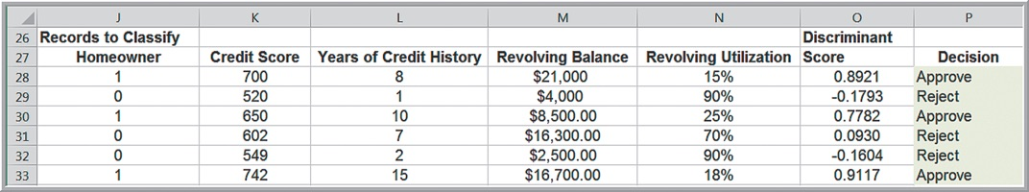
Example 10.7: Classifying Credit Decisions Using Discriminant Analysis (3 of 3)
Rule for classifying observations using the discriminant scores. Compute a cut-off value so that if a discriminant score is less than or equal to it, the observation is assigned to one group; otherwise, it is assigned to the other group.
One simple way is to use the midpoint of the average discriminant scores:
Cut-Off Value

Slide 32
Association Rule Mining
Association rule mining, often called affinity analysis, seeks to uncover associations and/or correlation relationships in large data sets.
Association rules identify attributes that occur together frequently in a given data set.
Market basket analysis, for example, is used to determine groups of items consumers tend to purchase together.
Association rules provide information in the form of if-then (antecedent-consequent) statements.

Slide 33
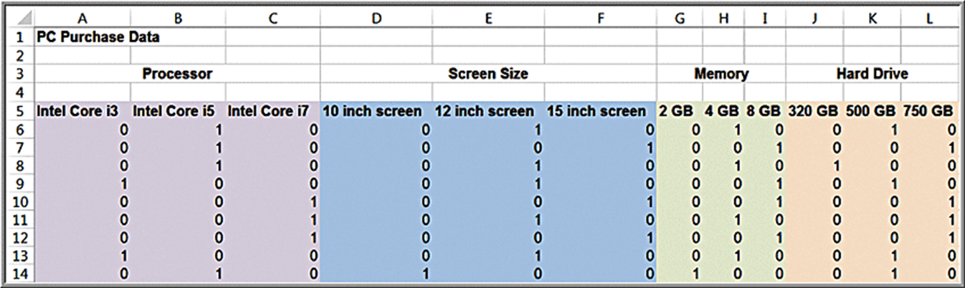
Example 10.8: Custom Computer Configuration
P C Purchase Data
We might want to know which components are often ordered together.

Slide 34
Measuring Strength of Association
Support for the (association) rule is the percentage (or number) of transactions that include all items both antecedent and consequent.
Confidence of the (association) rule is the ratio of the number of transactions that include all items in the consequent as well as the antecedent (namely, the support) to the number of transactions that include all items in the antecedent.
Lift is a ratio of confidence to expected confidence.
Expected confidence is the number of transactions that include the consequent divided by the total number of transactions.
The higher the lift ratio, the stronger the association rule; a value greater than 1.0 is usually a good minimum.

Slide 35
Example 10.9: Measuring Strength of Association
A supermarket database has 100,000 point-of-sale transactions; 2000 include both A and B items; 5000 include C; and 800 include A, B, and C.
Association rule: “If A and B are purchased, then C is also purchased.”
Support =
Confidence =
Expected confidence =
Lift =

Slide 36
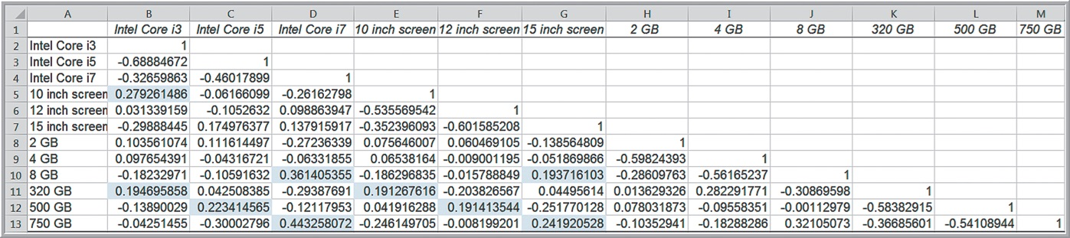
Example 10.10: Using Correlations to Explore Associations (1 of 2)
P C Purchase Data
The highest correlation is between the Intel Core i7 and a 750-G B hard drive. 8 of the 67 records have both of these components.

Slide 37
Example 10.10: Using Correlations to Explore Associations (2 of 2)
A simple association rule is If an Intel Core i7 is chosen (the antecedent), then a 750-G B hard drive is purchased (the consequent).
The support for this rule is 8, and the confidence is
The expected confidence is 17/67; thus, the lift is
Other correlations lead to other rules.

Slide 38
Cause-and-Effect Modeling
Correlation analysis can help us develop cause-and-effect models that relate lagging and leading measures.
Lagging measures tell us what has happened and are often external business results such as profit, market share, or customer satisfaction.
Leading measures predict what will happen and are usually internal metrics such as employee satisfaction, productivity, and turnover.

Slide 39
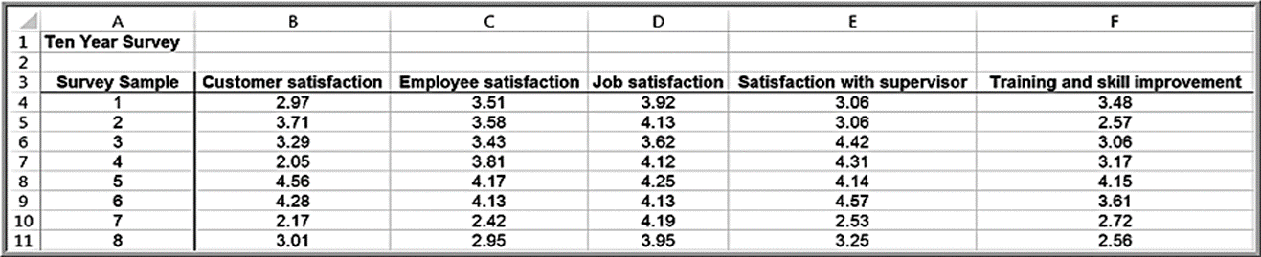
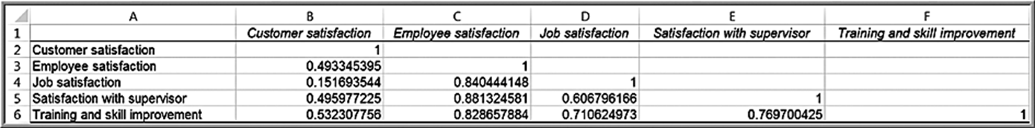
Example 10.11: Using Correlation for Cause-and-Effect Modeling (1 of 2)
Ten Year Survey data
Satisfaction was measured on a 1-5 scale.
Correlation matrix

Slide 40
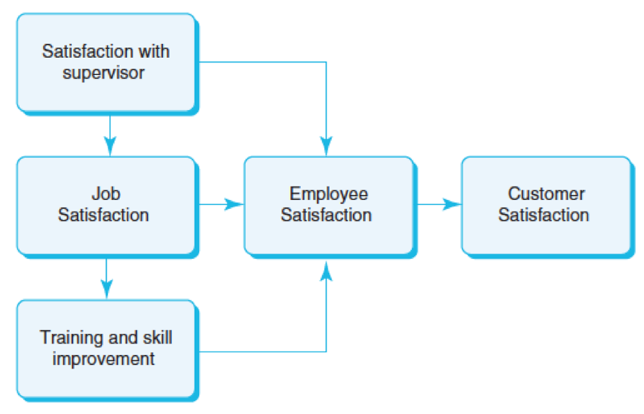
Example 10.11: Using Correlation for Cause-and-Effect Modeling (2 of 2)
Logical model

